Slide 1
Docker Swarm

Slide 2
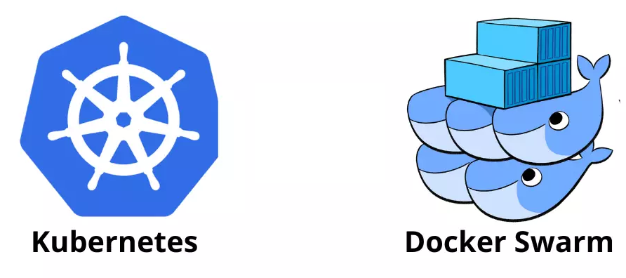
Container Orchestration
Docker CLI can containerise apps and deploy them with ease
In production serving 1000’s of users, using the CLI isn't a feasible option
To deploy and manage containers at scale you’ll need to use a container orchestration

Slide 3
Benefits of Container Orchestration tools
Easily scale containers (up/down)
Control how many instances of a container are running, Easily increase the scale of our operation when the user base increases
Increased redundancy and improved resiliency
if one instance of your container dies, there will be others to take its place
Deploy containers across multiple machines (nodes)
make use of more compute resources and improve system resiliency
Load balancing between containers to network traffic across nodes
Dynamically re-allocate containers across nodes -
if a node dies, containers on that node will be reallocated to the remaining nodes automatically
Rolling updates can be done without stopping or restarting any containers
Updates can be implemented without requiring any downtime for the end user

Slide 4
Docker Swarm
A swarm is a group of containers running across a group of machine (nodes) called a cluster
Is Docker's in-built container orchestration tool.
No extra installation requirements
Swarm has many components:
clusters, manager nodes, worker nodes and a network mesh for ingress traffic.
Notes:
Routing Mesh : Handles ingress traffic for every node for external requests to reach the correct service regardless of which node they arrive at.
Ingress Network: Sets up an ingress network for a service with public Port to handle incoming traffic on the published port.
Load Balancing: The Routing mesh load-balances incoming requests to the service across all running replicas of that service for high availability.
Internal Load Balancing: Swarm uses a combination of IPVS (IP Virtual Server) and IPtables rules to perform load balancing internally. These tools are configured to direct incoming packets to the appropriate service tasks based on the VIP.
Service Discovery
Each service is assigned a DNS name, which can be used by other services in the swarm to communicate with it using its service name.
Overlay Network
The ingress network is an overlay network providing isolated network for services.

Slide 5
Manager Nodes
This node can execute commands for managing the Swarm
Can have more than one Manager node in a cluster
for high availability, fault tolerance, lead election
When a cluster is initialised, the first node becomes the first manager.
It can produce a join token to allow more manager or worker nodes to join the cluster
Worker Nodes
Worker just run containers, complying with the manager nodes requests.
Containers for deployed services will be automatically provisioned evenly across worker nodes.
Manager and worker nodes

Slide 6

Communication between nodes
Nodes within a cluster communicate with one another
Balances the containers within the swarm across the cluster
making maximum use of compute resources
Also ensuring no node is being overworked

Slide 7
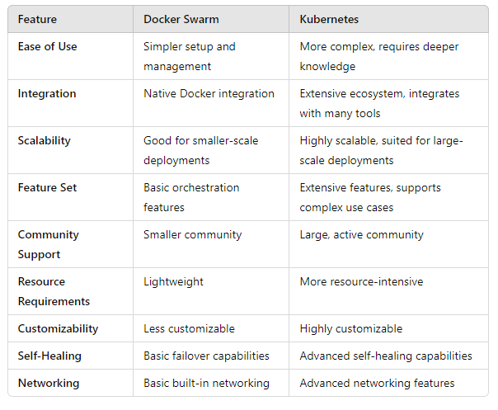
Docker Swarm vs Kubernetes

Slide 8
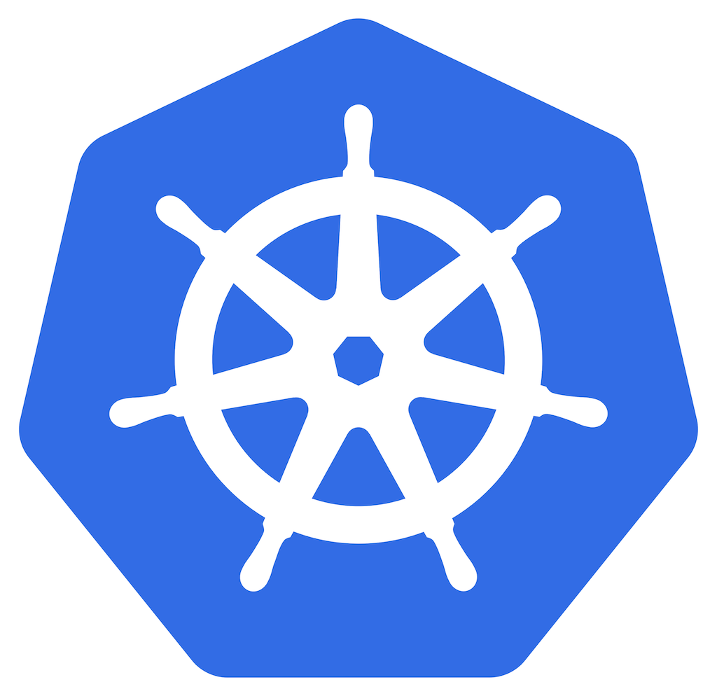
https://app.qa.com/lab/docker-swarm-playground/
Duration: 4h
Lab
Docker swarm playground
This Docker swarm playground lab provides you with a Docker swarm cluster running in Microsoft Azure.
The cluster is comprised of one manager node and two worker nodes.
The nodes have docker, docker-compose, and command-line completions pre-installed and ready for you to play with.
The cluster allows public access on ports 80, 443, and 8080.
Go further! Docker and K8s https://app.qa.com/learning-paths/building-deploying-and-running-containers-in-production-1-888/

Slide 9
Hope you enjoyed our session on Dockers

